Slide 1



CLassiq
DEVELOPMENT OF NOVEL QUANTUM ALGORITHMS

Slide 2



project overview
Implement an interactive protocol from the paper "Classically Verifiable Quantum Advantage from a Computational Bell Test” to demonstrate and verify quantum computational advantage.

Slide 3


PROJECT SOLUTION
Objectives
Use the classiq platform's Python SDK to implement the provided interactive protocol.
Show that the given protocol exhibits quantum advantage by verifying it through classical means.
Utilize the Python SDK of classiq to create each round of the protocol and work on integrating them into a single block of algorithm.

Slide 4

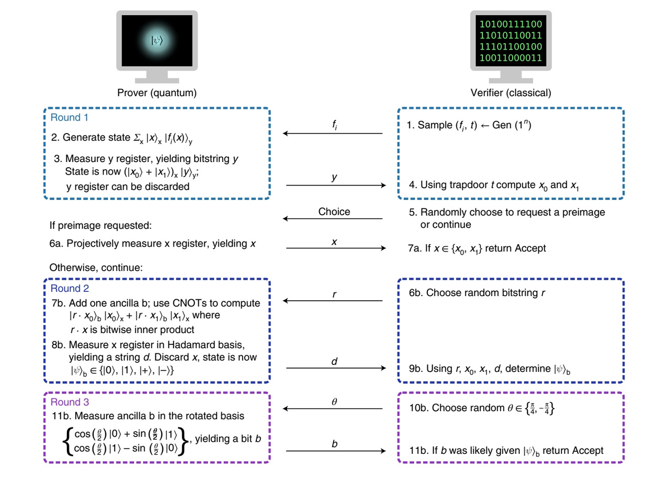
METHODOLOGY
Image credits: Classically verifiable quantum advantage from a computational bell test
Notes:
x^2 mod

Slide 5


METHODOLOGY
ROUND 1
We Implement the protocol as two parts. One a classical verifier and other a
quantum prover. We create certain functions to achieve the following.
Implementation
Two random prime numbers p and q are generated under the condition that both are congruent to 3 mod 4. N is selected as N= Thus p,q becomes the secret trapdoor data.
N is used in prover part to create x² mod N with the domain (N/2).A quantum circuit is created with two registers with states $Σ_{x}{\text{ |}\text{x}\text{〉}}_{x} |f_{i}{(x)}_{y}\text{〉}$ where f$(x)$= $x$² mod N is constructed .
Measured y state will be in ${\text{(∣}x_{0}\text{〉 + ∣}x_{1}\text{〉)}}_{x}{\text{∣}\text{y}\text{〉}}_{y}$.This measured y then given to verifier and using p,q and y, $x_{0}$and $x_{1}$ are calculated using Rabin’s decryption method.
$$p∗q.$$
Notes:
x^2 mod

Slide 6

METHODOLOGY
ROUND 2
A random bit is chosen and the bitwise inner product (rꞏx) with the x register
is implemented using an ancilla bit and x register is measured in hadamard
basis |${ψ\text{〉}}_{b}$ $∈\text{\{}$|0$\text{〉}$, |1$\text{〉}$, |+$\text{〉}$, |-$\text{〉}$}.
Implementation
For accuracy, x was equated to another integer and the bitwise inner product (rꞏx)
was calculated by applying the CNOT gates
Using r, $x_{0}$, $x_{1}$ and d, we determine |${ψ\text{〉}}_{b}$ using a classical function.
Notes:
x^2 mod

Slide 7

METHODOLOGY
ROUND 3
A random angle θ = + $π$/4 or -$π$/4 is chosen and the ancilla qubit measured
in rotated basis to yield a bit b which should demonstrate a quantum
advantage of probability of approximately 0.85.
Implementation
Earlier, CNOT gates were applied to the ancilla qubit for measurements.
Now, to measure it in a rotated basis , an RY gate was applied with θ = + $π$/4
which resulted in attaining a required quantum advantage probability of 0.85.
If the bit b is same as the more likely outcome, then we return Accept.
Notes:
x^2 mod

Slide 8






PROJECT BLOCKS AND WINS
Blocks: Although we almost achieved toy problem implementation using seperate code blocks, we failed to create the exact replica of the ciruit of $x$² mod N, as mentioned in the paper.
What we did: To Compensate this, we have implemented $x$² mod N successfully for the case of three qubits using CNOT gates.
Wins: We were able to execute all the steps in Round 2 and 3 completely but by manually injecting values from each code block to the next.

Slide 9

WHAT WE LEARNED SO FAR
This protocol has potential to execute trapdoor claw free functions with reduced circuit complexity which may bring quantum advantage with current quantum devices.
However there are some practical limitations; For increasing security, we need to choose larger prime numbers requiring more qubits which is not possible with current simulators.

Slide 10

FUTURE SCOPE
To extend our project as a team with beginners, we
are planning to improve ourselves in key areas ;
Developing a comprehensive knowledge on implementation of advanced arithmetic logic in quantum circuits.
Understanding neutral atom quantum hardware platforms and implement the protocol as a further step.

Slide 11

thankyou!
TEAM : QUANT𝗂N

